Slide 1
MGMT-6064 PROJECT LEADERSHIP AND MANAGEMENT
Module 7: Project Team Development

Slide 2
Objectives
Definition of teams
Five stages of team development (Tuckman)
Punctuated Equilibrium model of team development (Gersick)
Delegation

Slide 3
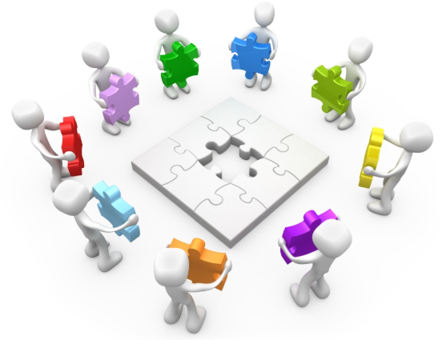
teams
What teams have in common:
Share common objectives
Depend on each other (even though they may work independently on their tasks)
Are goal-oriented
Have complementary skills
How teams may differ:
Task interdependency
Fluidity of membership
Presence of a formal leader
Amount of physical interaction (colocation vs. virtual)
Duration
Previous experience with each other
Composition (e.g., functional, cross-functional)
Etc.
Notes:
Image: https://barcelona.inno-forum.org/wp-content/uploads/sites/5/2016/06/Project-Team.jpg

Slide 4
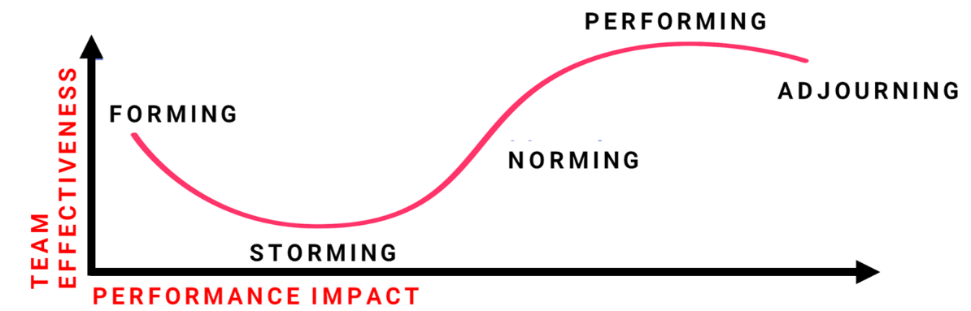
Stages of Team Development (Tuckman)
Each stage has its own particular challenges, characteristics and tasks – with implications for the project leader
(video)
Notes:
Image Source: https://chartec.net/is-your-team-growing-you-need-to-understand-the-5-stages-of-team-development/

Slide 5

Forming
Questions and concerns:
What is expected of me and why am I here?
Who are my team members, will I be able to work effectively with them?
Who is the PM and what is his/her role, style or credibility?
Emotions:
Politeness, optimism, excitement, uncertainty, awkwardness
(video)
Notes:
Image: http://2.bp.blogspot.com/-LdifLB_nDH4/VpXI0QP-1sI/AAAAAAAADSQ/gNlW8U5-jXE/s1600/Team-Helping.jpg

Slide 6
Leadership style & activities - Forming
Leadership style: Directing Hold a kick-off meeting, introduce everyone Explain and answer questions about: objectives, priorities, team member roles, stakeholder (and your) expectations for the project and for the team itself Establish team processes and ground rules Practice openness and transparency, explaining “what” and “why” Start to promote a culture that models and values teamwork Enable/encourage team members to get to know each other
Notes:
Source: http://2.bp.blogspot.com/-LdifLB_nDH4/VpXI0QP-1sI/AAAAAAAADSQ/gNlW8U5-jXE/s1600/Team-Helping.jpg
Text from assigned readings and also:
Arora, M. & Baronikian, H. (2013). Leadership in project management: Leading people and projects to success (2nd ed). Toronto: Leadership Publishing House.

Slide 7
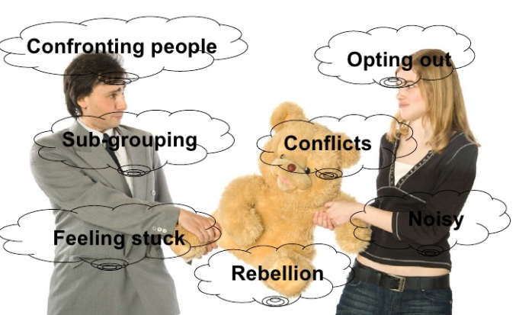
Storming
Some projects fail because teams never get past this stage
Challenges/power struggles: from member(s) to PM, and also among the team members themselves
Differences in personalities, working styles, attitudes, expectations, opinions, etc.
Team members aren’t committed or comfortable with their roles/tasks
Weak team member relationships, lack of trust
Team members manage conflict in different ways (e.g., hostility, resistance, avoidance, etc.)
(video)
Notes:
Image: http://image.slidesharecdn.com/stagesofteamdevelopment-12853499493489-phpapp01/95/stages-of-team-development-3-728.jpg?cb=1285333060

Slide 8
Leadership style & activities – Storming
Leadership style: Coaching (may need to shift back and forth with directing) Check for understanding, inviting and providing feedback. Facilitate understanding and conflict resolution. Reinforce that storming is natural and things will get better (explain Tuckman model to team). Intervene where conflict is serious or persistent, change team membership if needed. Take an active listening/problem-solving approach – consider different points of view. Clarify/reinforce ground rules, expectations, processes, values, tasks. Stay positive & firm in the face of challenges to your own leadership or project goals. Allow creative tension & positive conflict, so the team becomes comfortable with each other’s ideas and opinions.
Notes:
Image: http://image.slidesharecdn.com/stagesofteamdevelopment-12853499493489-phpapp01/95/stages-of-team-development-3-728.jpg?cb=1285333060
Text from assigned readings and also:
Arora, M. & Baronikian, H. (2013). Leadership in project management: Leading people and projects to success (2nd ed). Toronto: Leadership Publishing House.

Slide 9
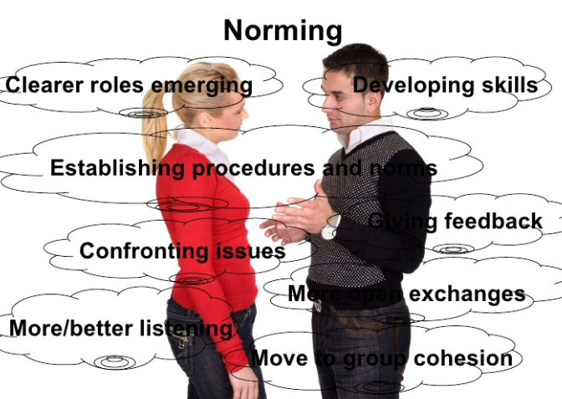
Norming
Team members start to resolve their differences, grow trust, develop cohesion
Norming = developing norms or habits/patterns for dealing with conflict, decision-making, problem-solving, leadership behaviour, etc. (culture is becoming stronger)
Team members are more comfortable giving constructive feedback, asking for help
Team is now working towards a single shared goal (more productive)
Overlap between storming and norming as new situations arise
Not all teams get to this stage (video)
Notes:
Image: https://d1fhzurqmm0rwe.cloudfront.net/wp-content/uploads/2016/11/norming-stage.jpg

Slide 10
Leadership style & activities - Norming
Leadership style: Participating Allow the team to become more autonomous, stepping back and enabling the team to take responsibility for progress. Demonstrate support to all team members. Organize social events/ team-building activities to continue building cohesion and trust. Reinforce and model team norms, ground rules and expectations. Ensure resolution of interpersonal conflicts. Monitor for progress, issues and conflicts.
Notes:
Image: https://d1fhzurqmm0rwe.cloudfront.net/wp-content/uploads/2016/11/norming-stage.jpg
Text from assigned readings and also:
Arora, M. & Baronikian, H. (2013). Leadership in project management: Leading people and projects to success (2nd ed). Toronto: Leadership Publishing House.

Slide 11

Performing
Leadership Style and Activities
Leadership style: Delegating Let the team make most of the decisions, raise issues or problems, and find solutions. Delegate as much as possible, focusing on team member goals and development, to support growth of skills, confidence and responsibility. Focus own energy on stakeholder relations, sponsor interaction, championing the project and removing project roadblocks.
High team productivity
Team processes are well established
Higher levels of commitment, pride, morale
Not all teams get to this stage
(video)
Notes:
Image: http://ibi-global.com/userfiles/image/ibi-high-performing-team-9665.png
Text from assigned readings and also:
Arora, M. & Baronikian, H. (2013). Leadership in project management: Leading people and projects to success (2nd ed). Toronto: Leadership Publishing House.

Slide 12

Adjourning
Leadership Style & Activities
Leadership style: Detaching Celebrate success, reward team members for their contribution Conduct a debrief meeting (s) to review the project experience and identify ‘lessons learned’ Release resources and assist team members toward their next assignment (where possible)
This stage occurs at the end of the project
May be abrupt if the project is suddenly terminated due to:
Shift in organizational priorities
Changing market conditions
Poor project performance, etc.
Team members may feel unhappy, uncertain, or anxious about the future (regardless of why the project ended)
(video)
Notes:
Image: http://www.pm-primer.com/wp-content/uploads/2012/04/party.jpg
Text from assigned readings and also:
Arora, M. & Baronikian, H. (2013). Leadership in project management: Leading people and projects to success (2nd ed). Toronto: Leadership Publishing House.

Slide 13
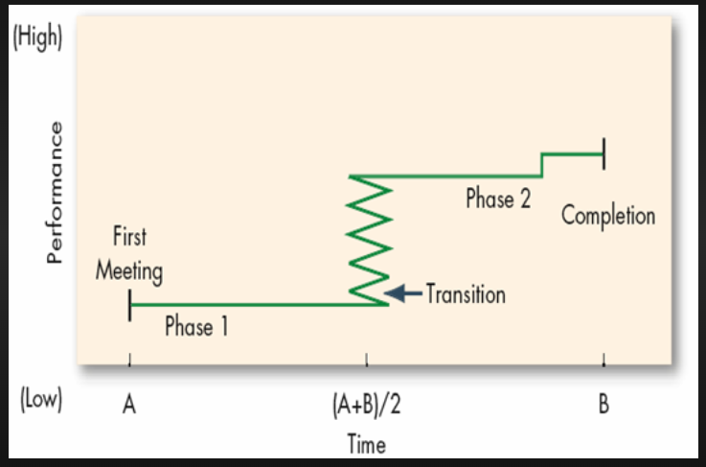
Punctuated equilibrium model (gersick)
Temporary teams might not have time (or interest) to proceed through the stages of the Tuckman model
Stages of model:
Early stage (First meeting)
Inertia
Mid-stage transition
Inertia
End stage
Equilibrium (inertia) is “punctuated”, or interrupted, by transitions typically starting half-way between the beginning and end of the project

Slide 14
Punctuated equilibrium model (gersick)
Early stage (First meeting): Introduction to each other and to the project, timetables tasks defined, final deadline established
Inertia: “The pressure is off… this work isn’t an immediate priority… I’ll work on this later” or “we’ll work independently on our tasks for a while and won’t be in touch with each other”
Mid-stage transition: Realization that little or no progress has been made, scramble to get some work done, commitment to making this a higher priority so things are back on track, there may be a change in procedures and tasks
Inertia: “I’ve made some progress… I’ll turn my attention to other priorities and will come back to this later”
End stage: Deadline is looming, significant work activity to finish tasks, more communication among members

Slide 15
Punctuated equilibrium model (gersick)
More common when:
Team members are able to work independently on their tasks
Teams do not have a formal project manager/leader
Team members have other projects or commitments underway
The project is ‘waterfall’ rather than ‘agile’
Conflict patterns are different, compared to the Tuckman model
Recommendation for leaders or self-managed team members:
Clarify roles and responsibilities at the start
Create multiple milestones or progress check-points throughout the project

Slide 16
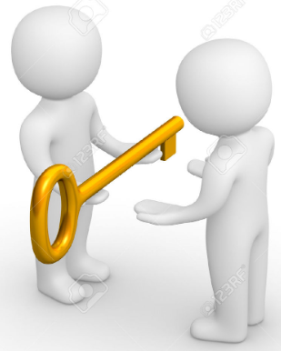
Delegation
Assigning responsibility and authority to someone to complete a defined and agreed upon task while you retain ultimate accountability
Benefits:
Frees up leader’s time, so he/she can focus on other activities
Provides team member with opportunities to learn and develop
Allows team members to be involved in tasks
Allows leaders to observe and evaluate team members in new tasks
Increases team member motivation and satisfaction
Grooms future leaders
Delegation is NOT the same thing as allocating work! (video)
Notes:
Image: http://clipground.com/images/delegate-clipart-1.jpg

Slide 17
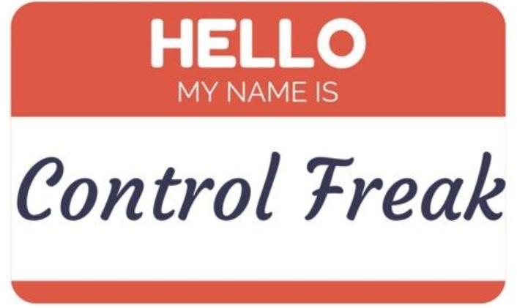
Why do leaders resist delegating?
Leader’s personality style
Desire to keep power and control
Fear of losing power
Lack of trust in subordinates
Belief that the leader can do it faster or better without delegating
Fear of being held accountable for the delegate’s mistakes
Notes:
https://s-media-cache-ak0.pinimg.com/originals/99/d1/2a/99d12a76e5ad7742af9999bd174cb6eb.jpg

Slide 18

Guidelines for good Delegation
Do not delegate a task to someone who isn’t competent or capable of completing it
Don’t overburden team members who may already be too busy
Tolerate different approaches that the delegate might use when completing his/her task
Delegate, do not dump
Clarify goals and expectations
Provide support and authority
Monitor and provide feedback
Delegate to different followers
Create a safe environment
Notes:
https://myob-gm-digital-production-blog-assets.s3.amazonaws.com/uploads/2016/04/How-to-delegate-effectively-blog.jpg

